Slide 1
Neurorep bibliometric data analysis in VOSviewer
Dataset: processed_data/wos+cwts_nonexcluded_records_data.csv

Slide 2
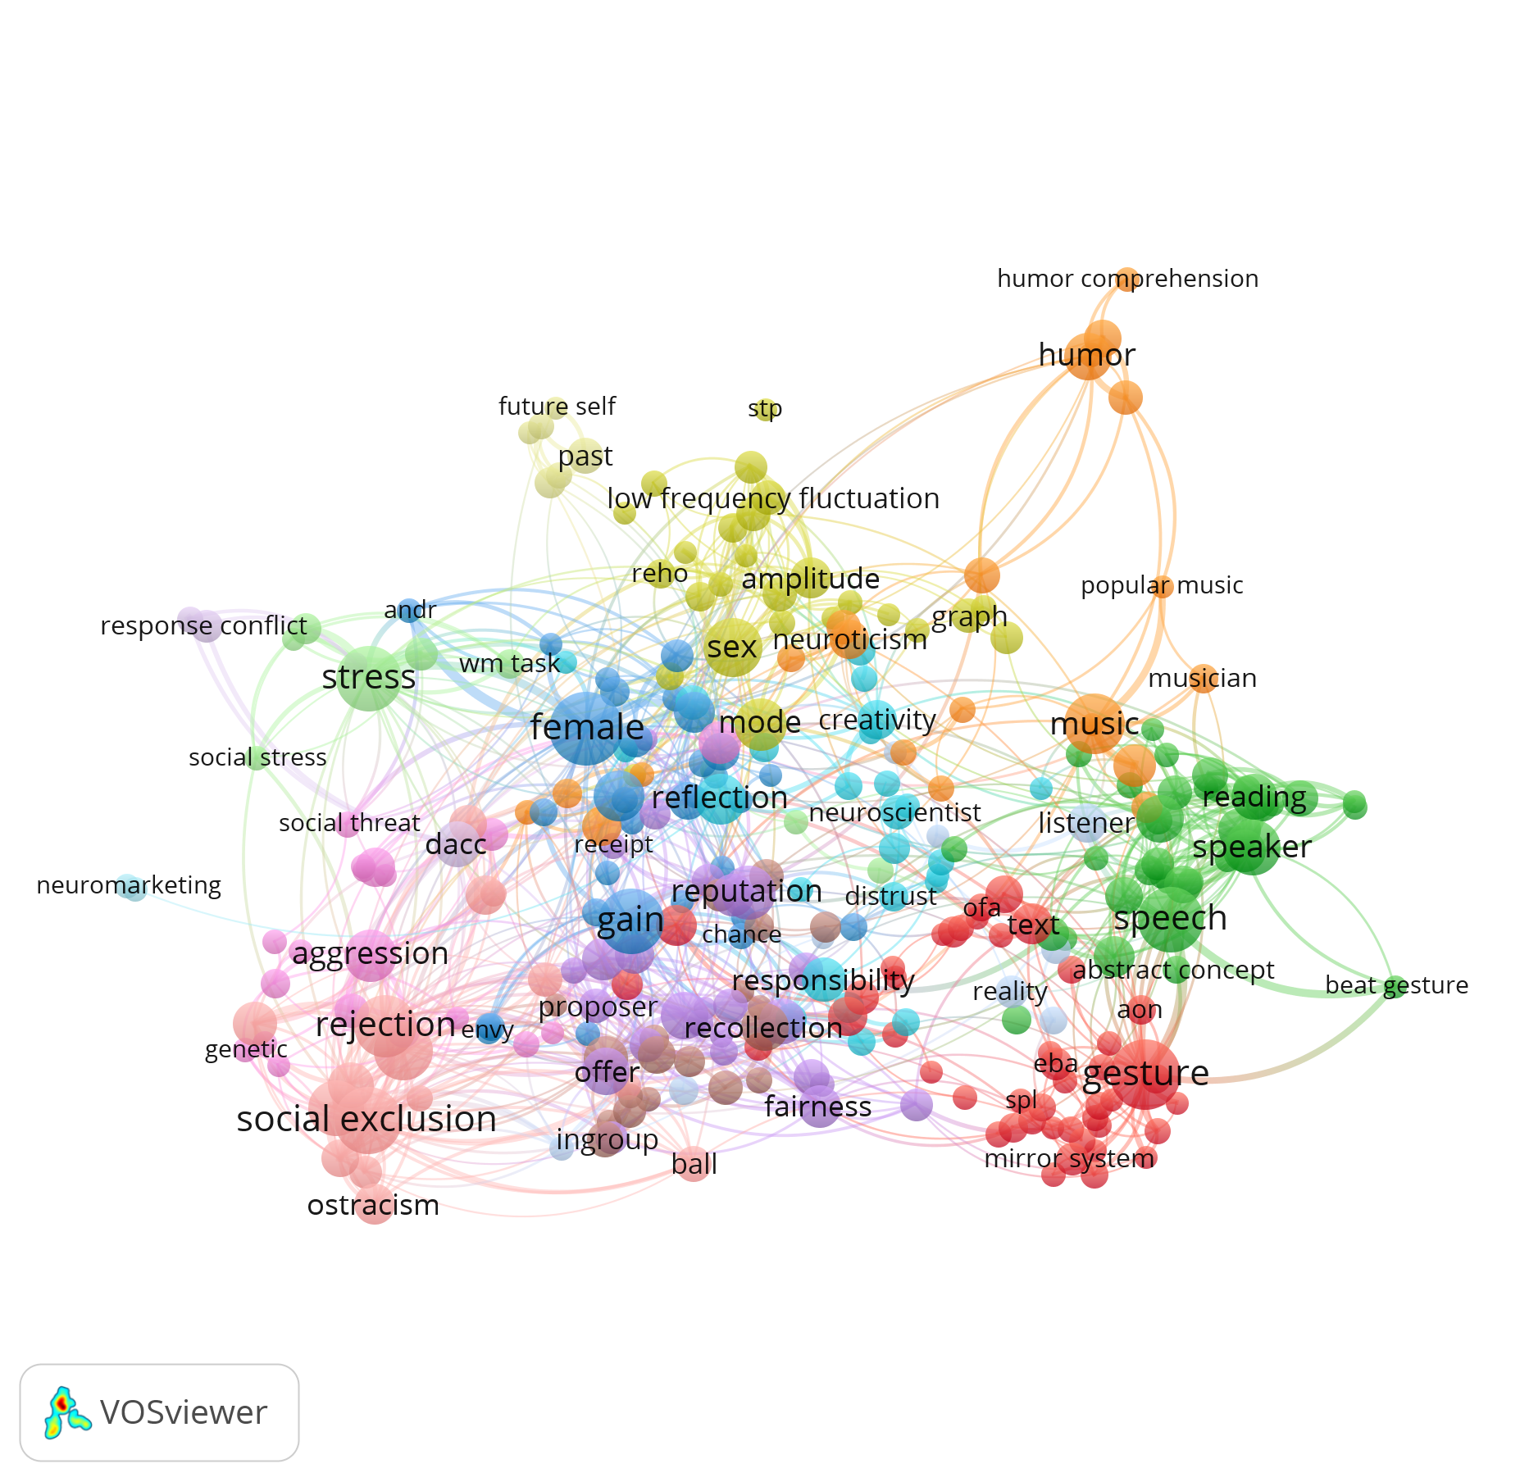
Title and abstract Full counting Mentioned: >=10 Relevance: 300 (~20% most relevant records)

Slide 3
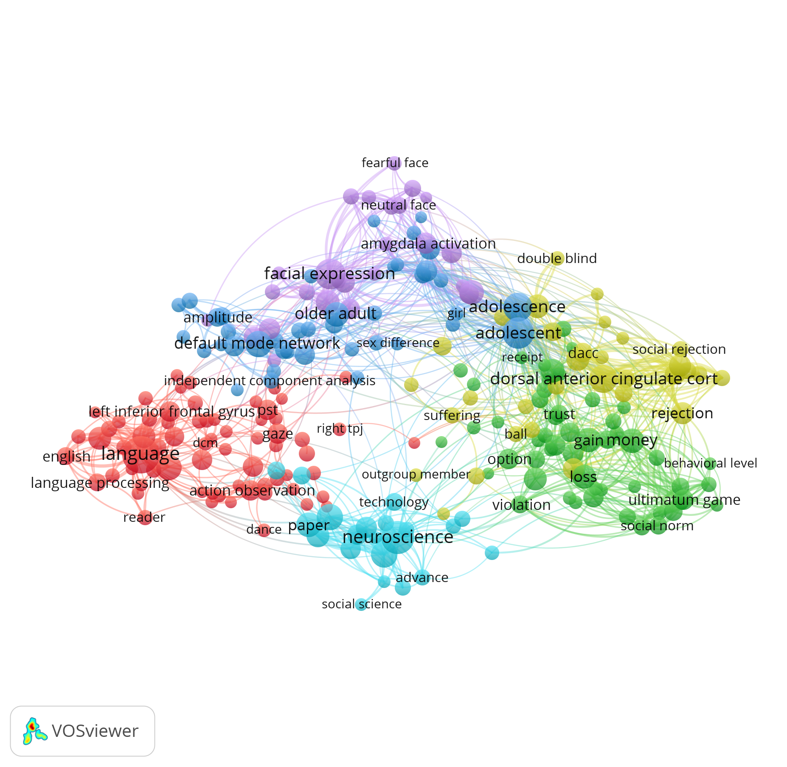
Title and abstract Binary counting Mentioned: >=10 Relevance: 240 (~20% most relevant records)

Slide 4
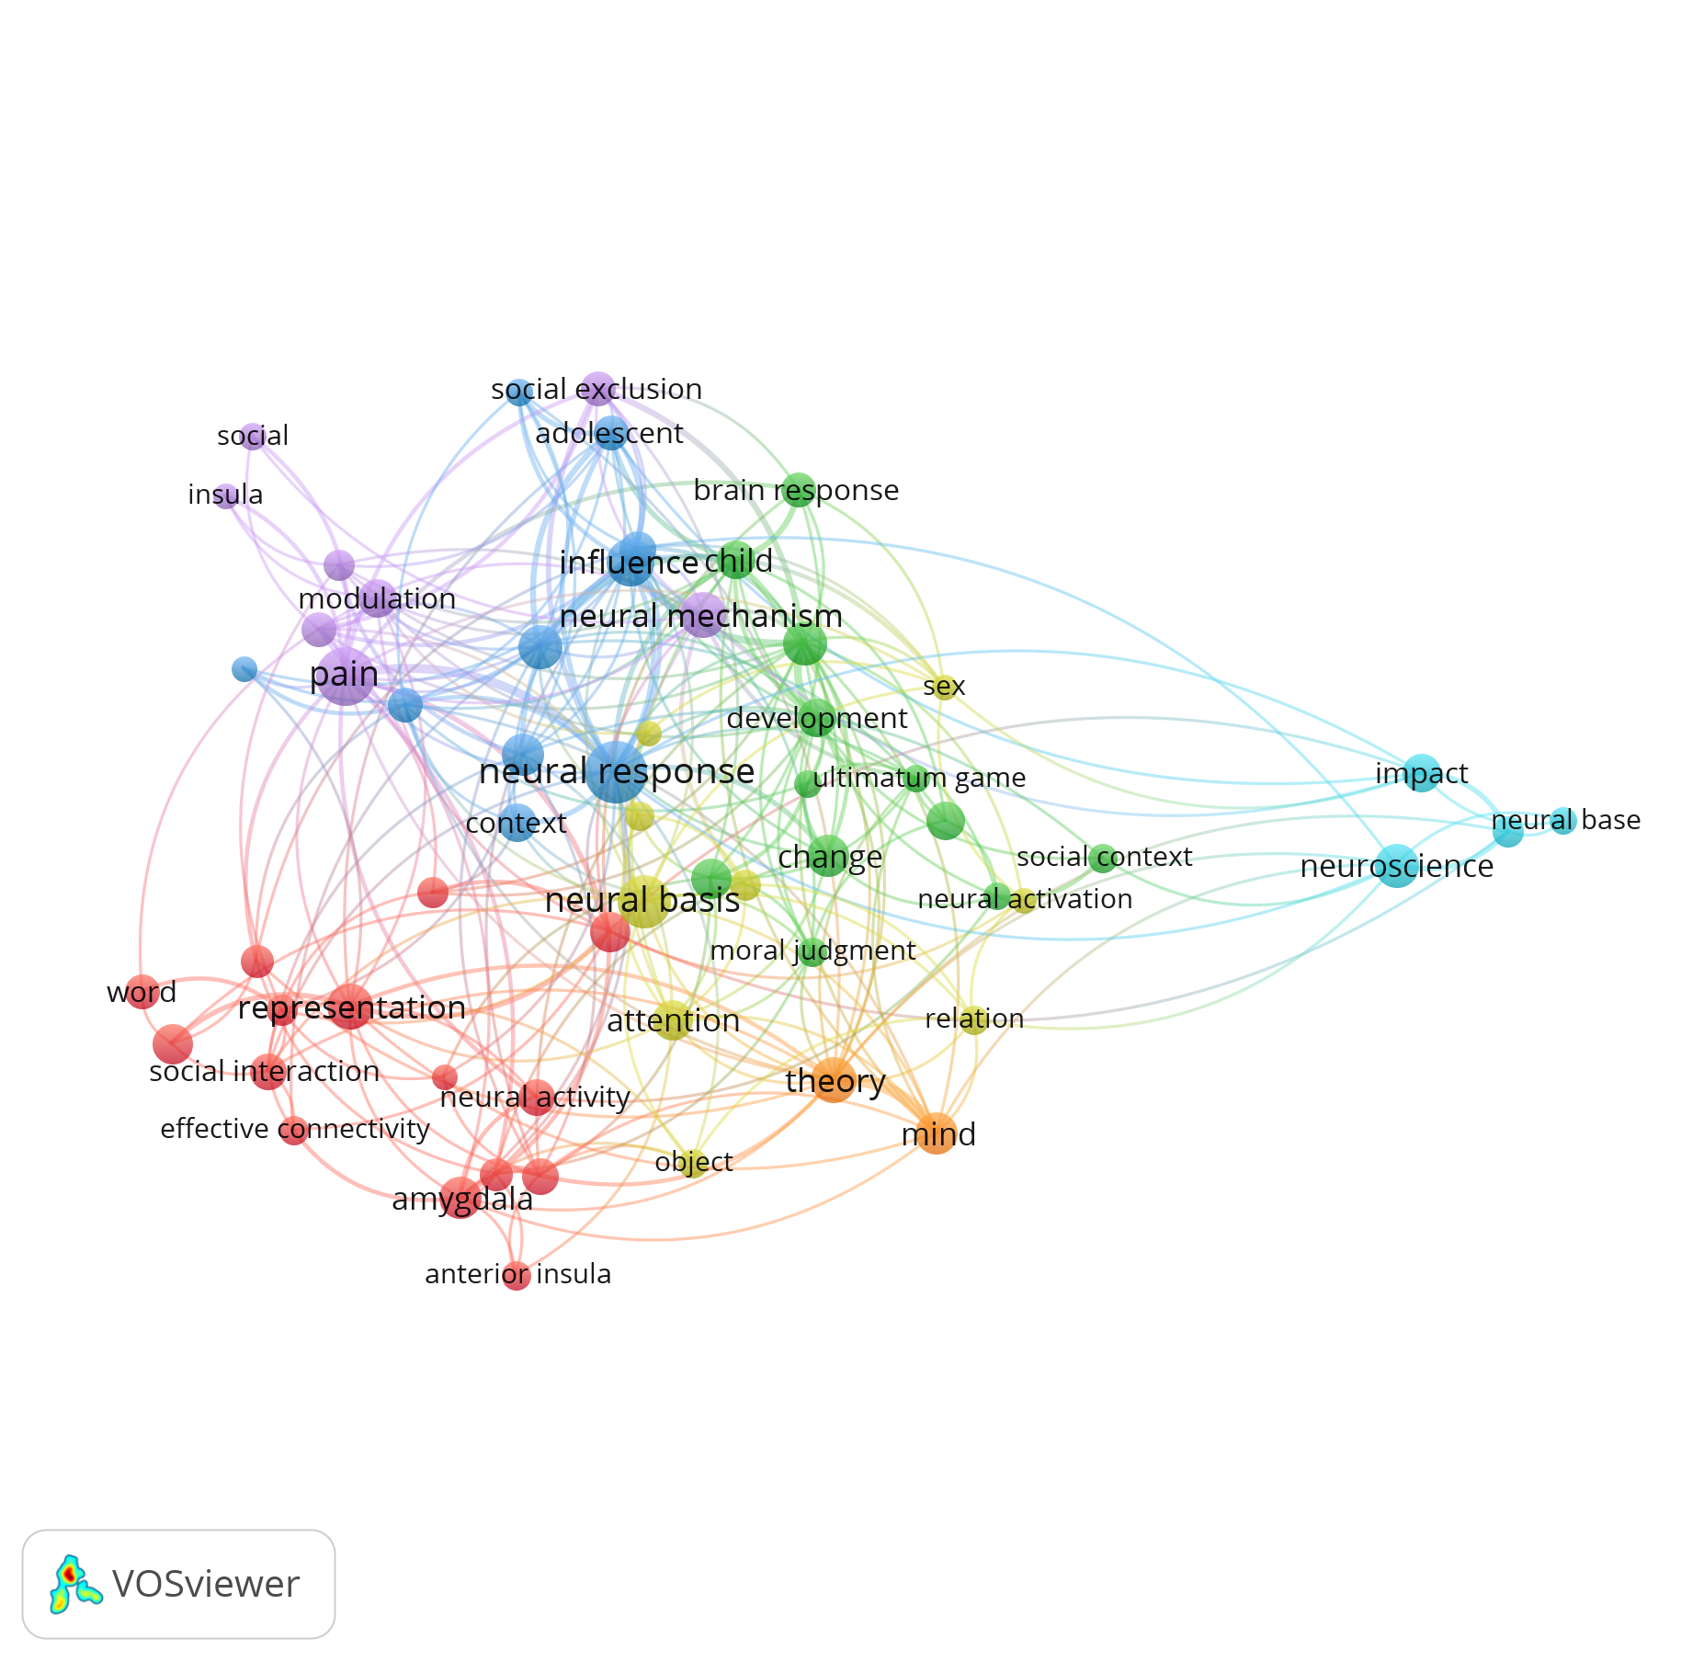
Only title

Slide 5
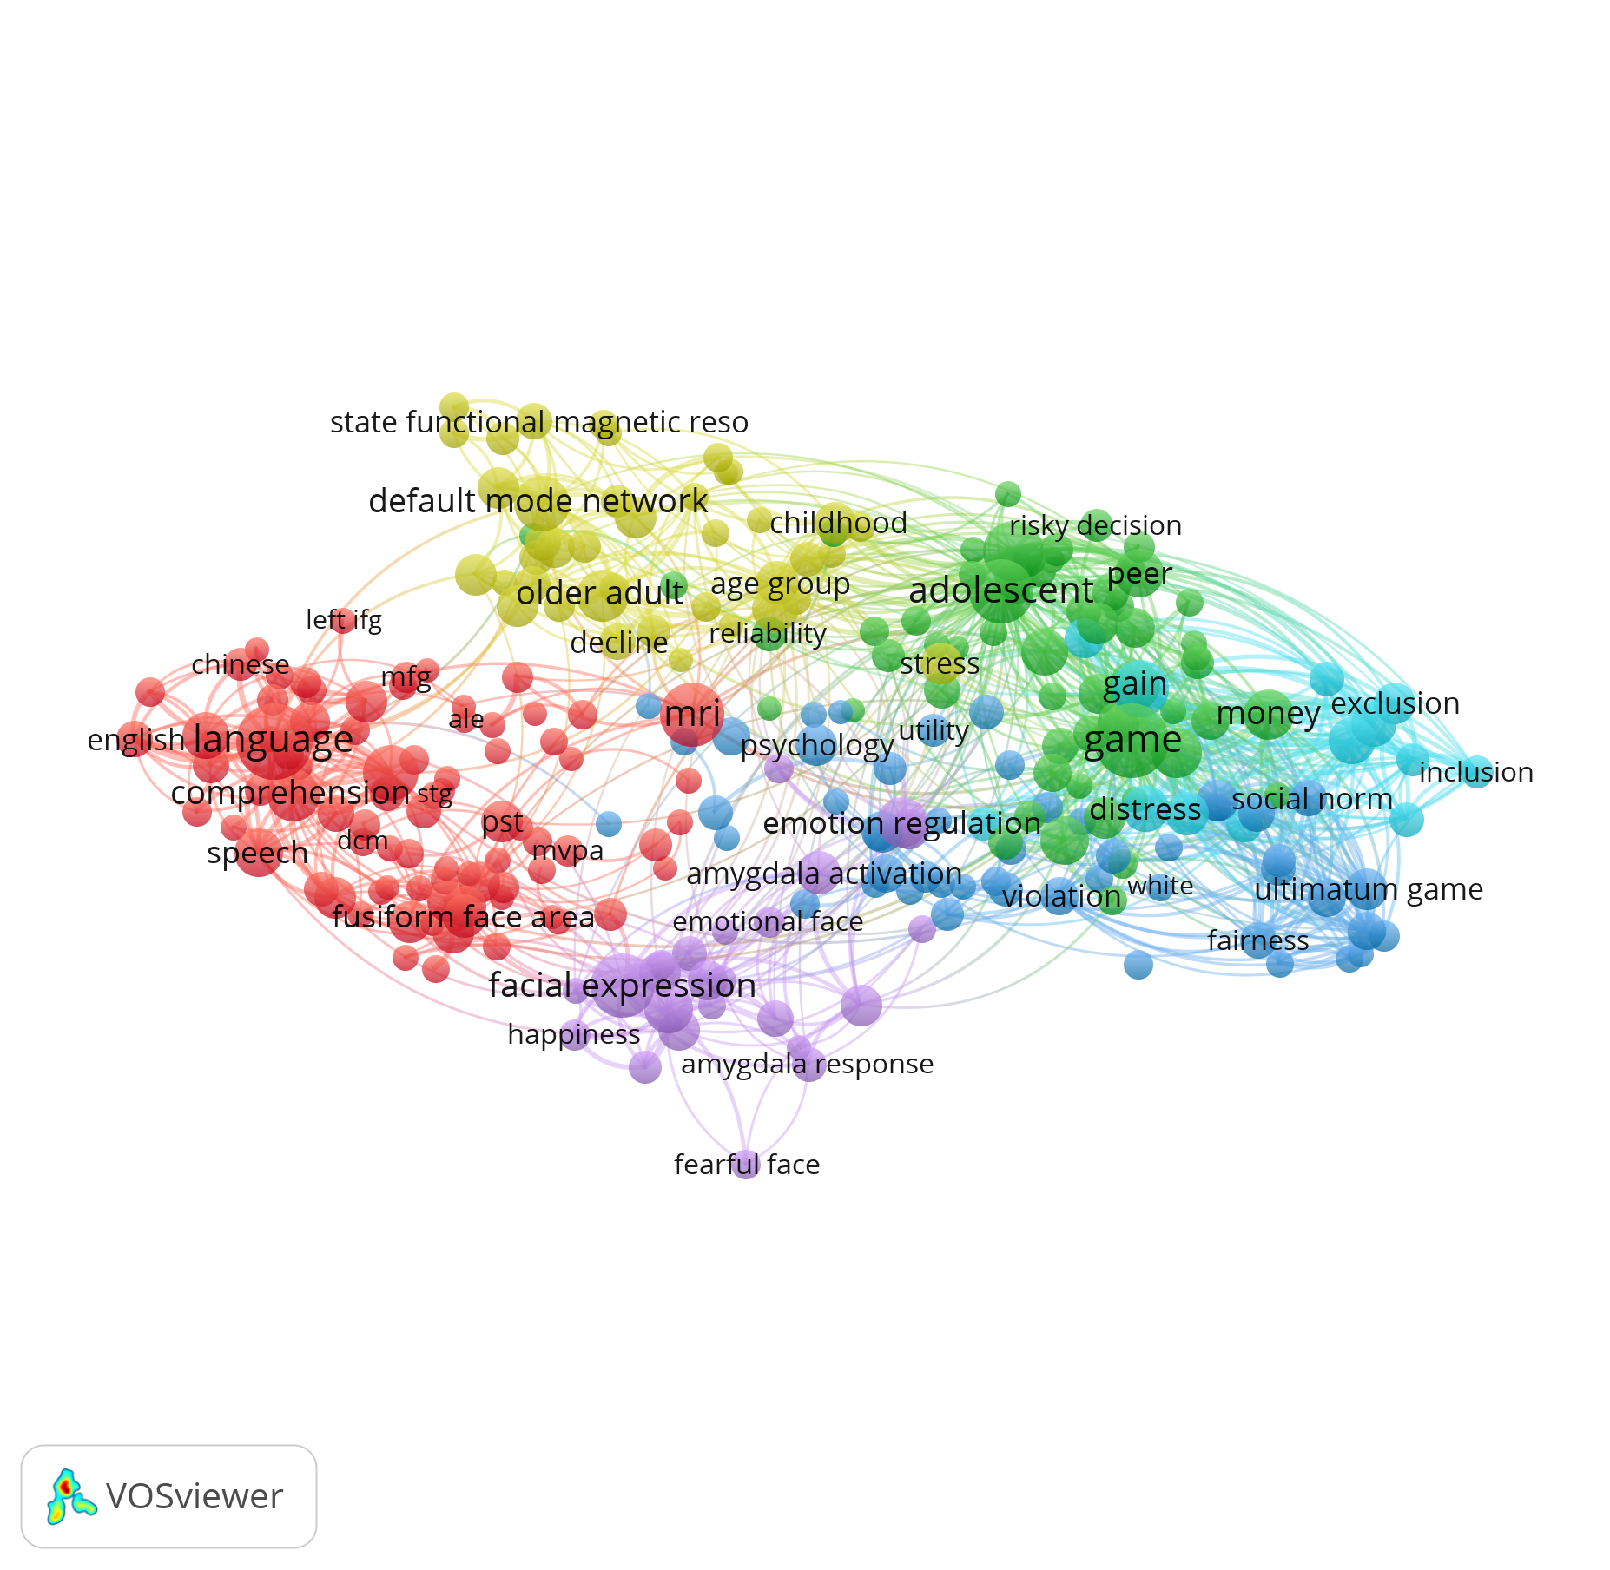
Title and abstract Binary counting Mentioned: >=10 Relevance: 240 (~20% most relevant records) Generic terms excluded

Slide 6
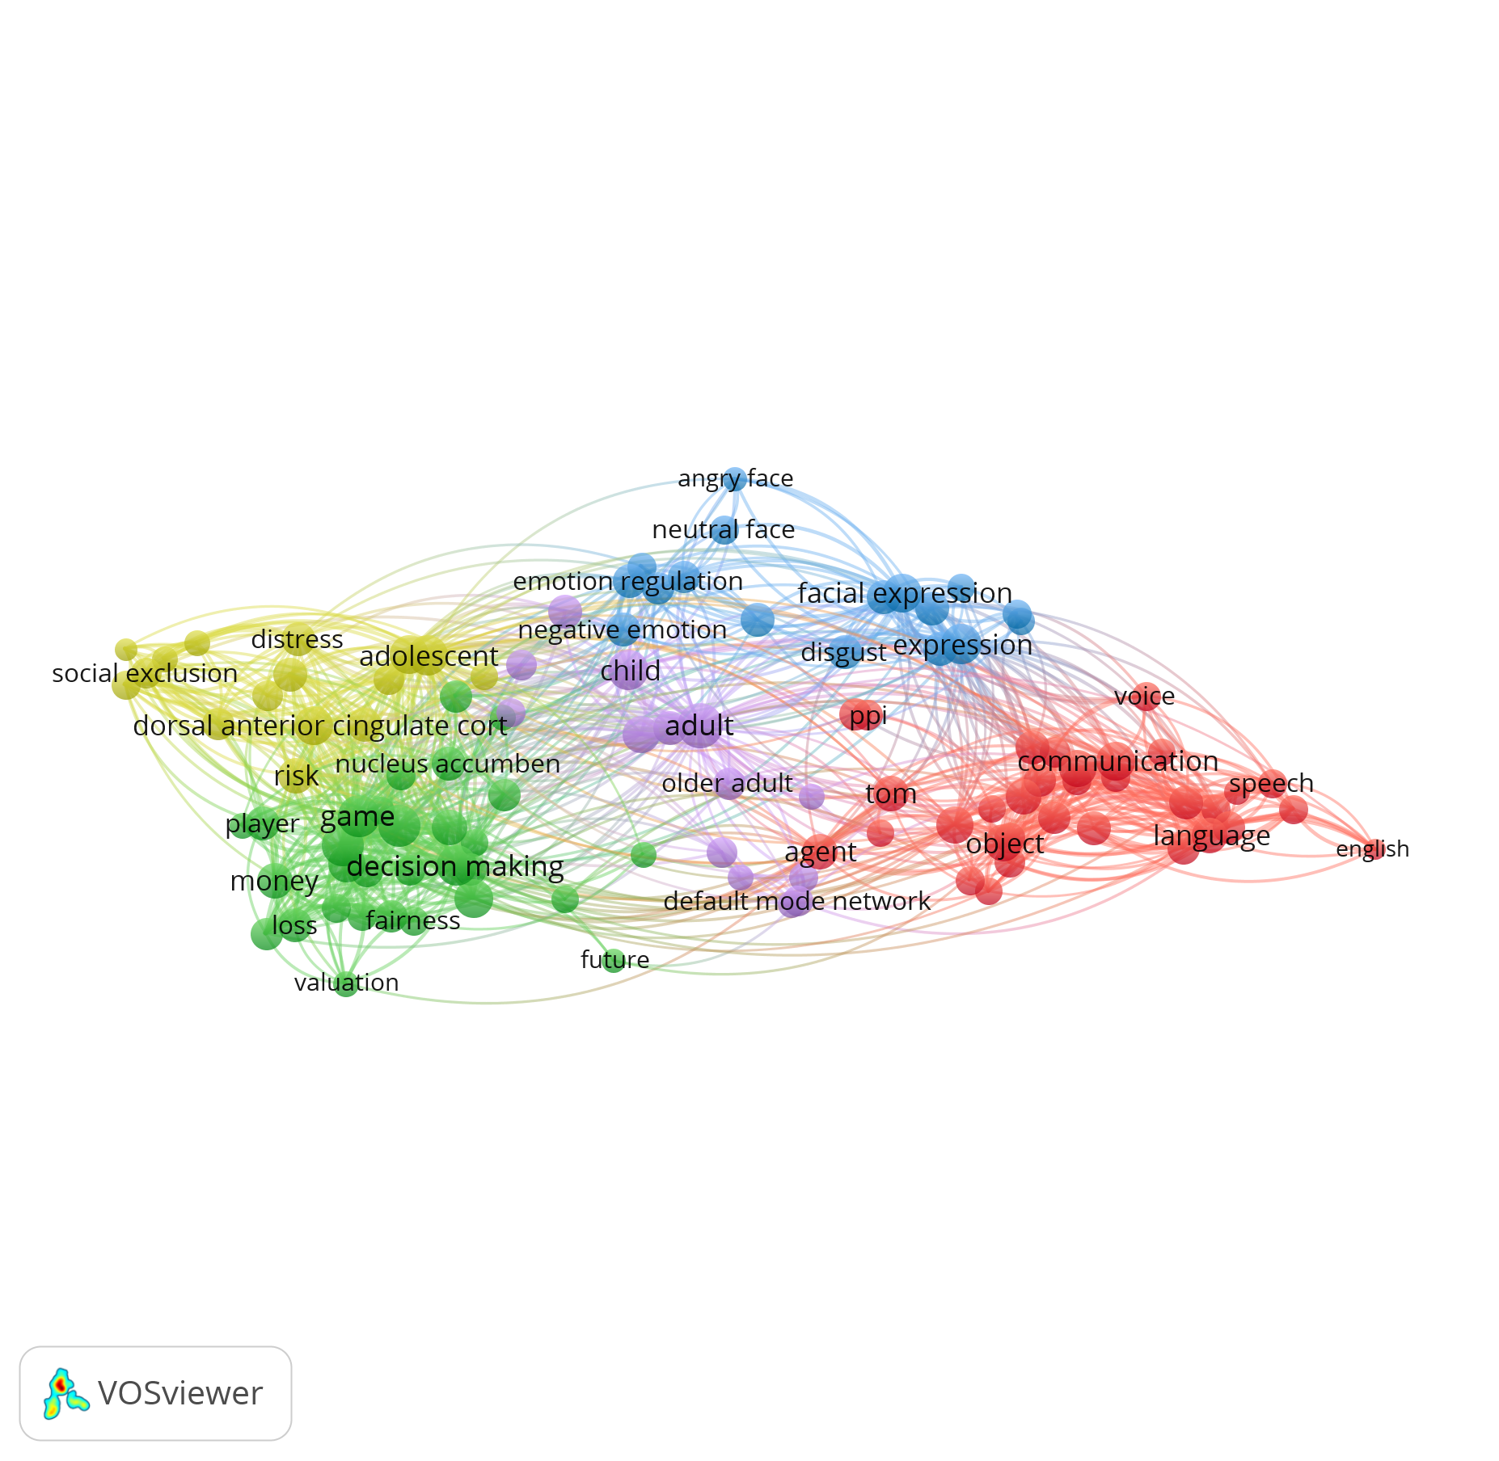
Title and abstract Binary counting Mentioned: >=20 Relevance: 120 (~20% most relevant records) Generic terms excluded

Slide 7
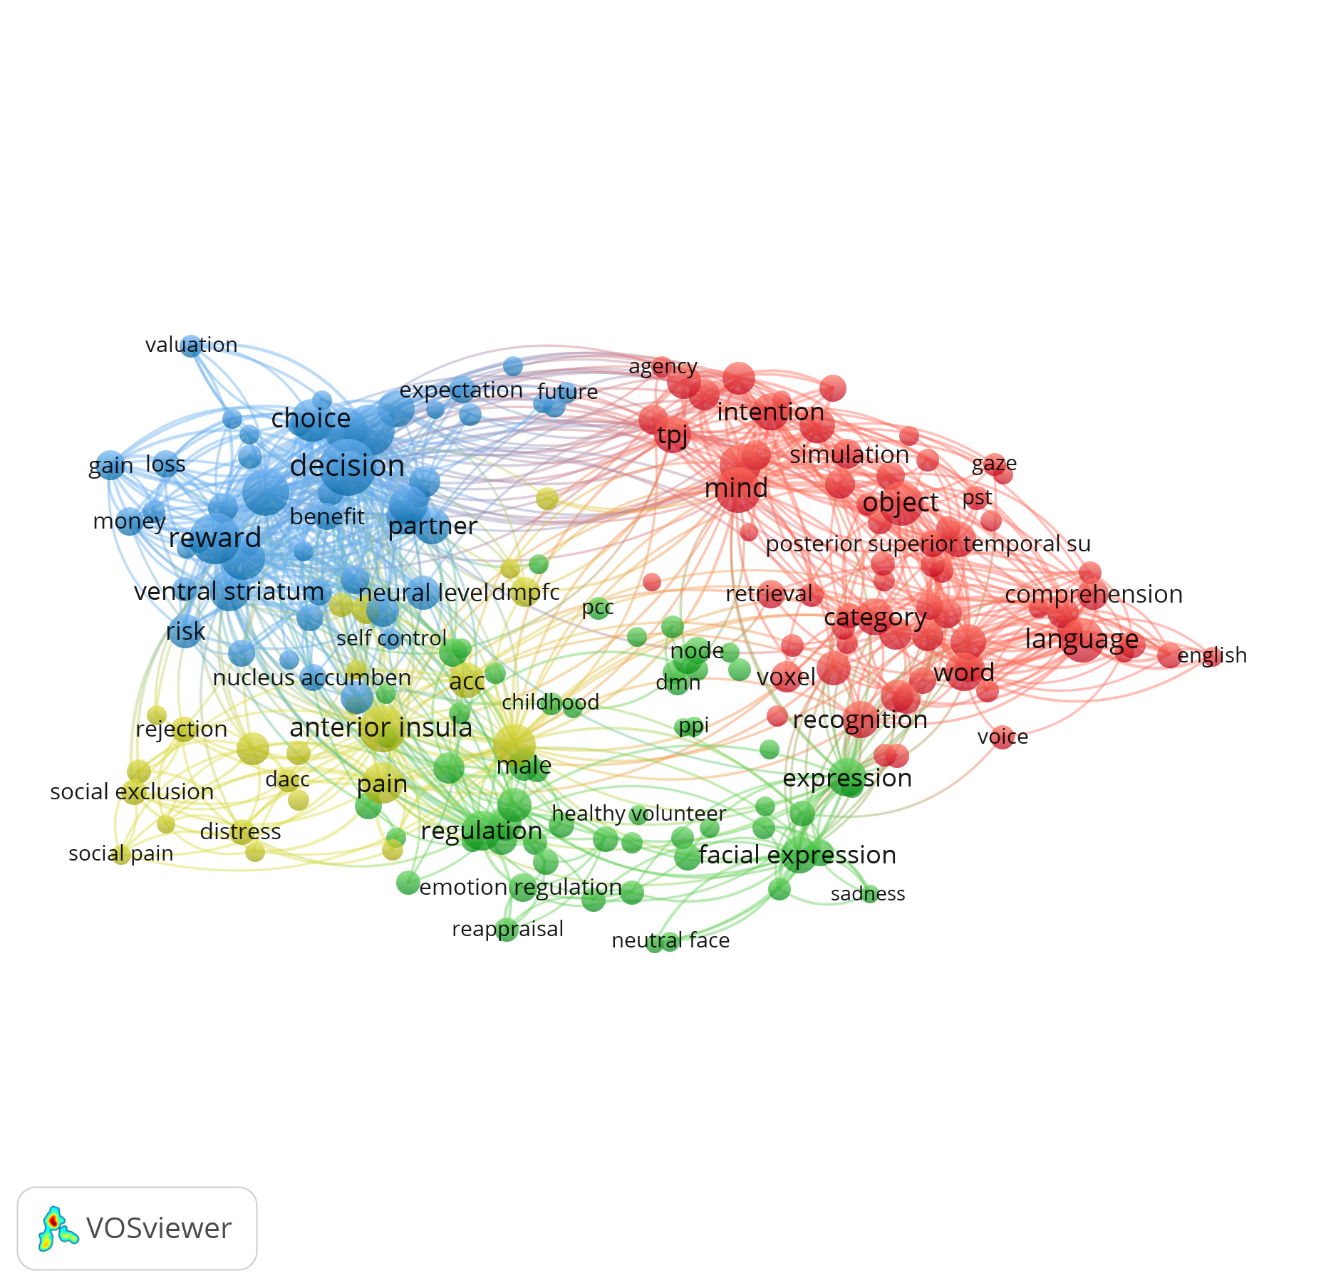
Title and abstract Binary counting Mentioned: >=20 Relevance: 200 (~40% most relevant records) Generic and age terms excluded

Slide 8
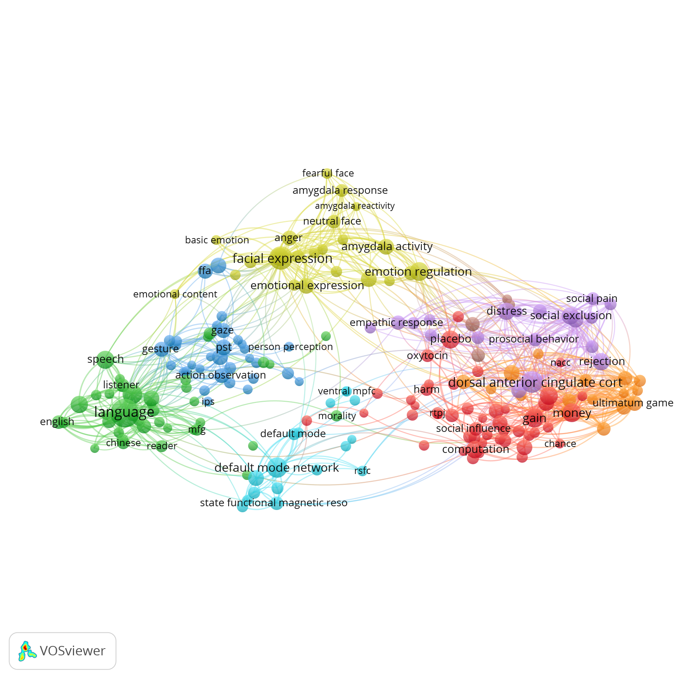
Title and abstract Binary counting Mentioned: >=10 Relevance: 200 (~20% most relevant records) Generic and age terms excluded

Slide 9
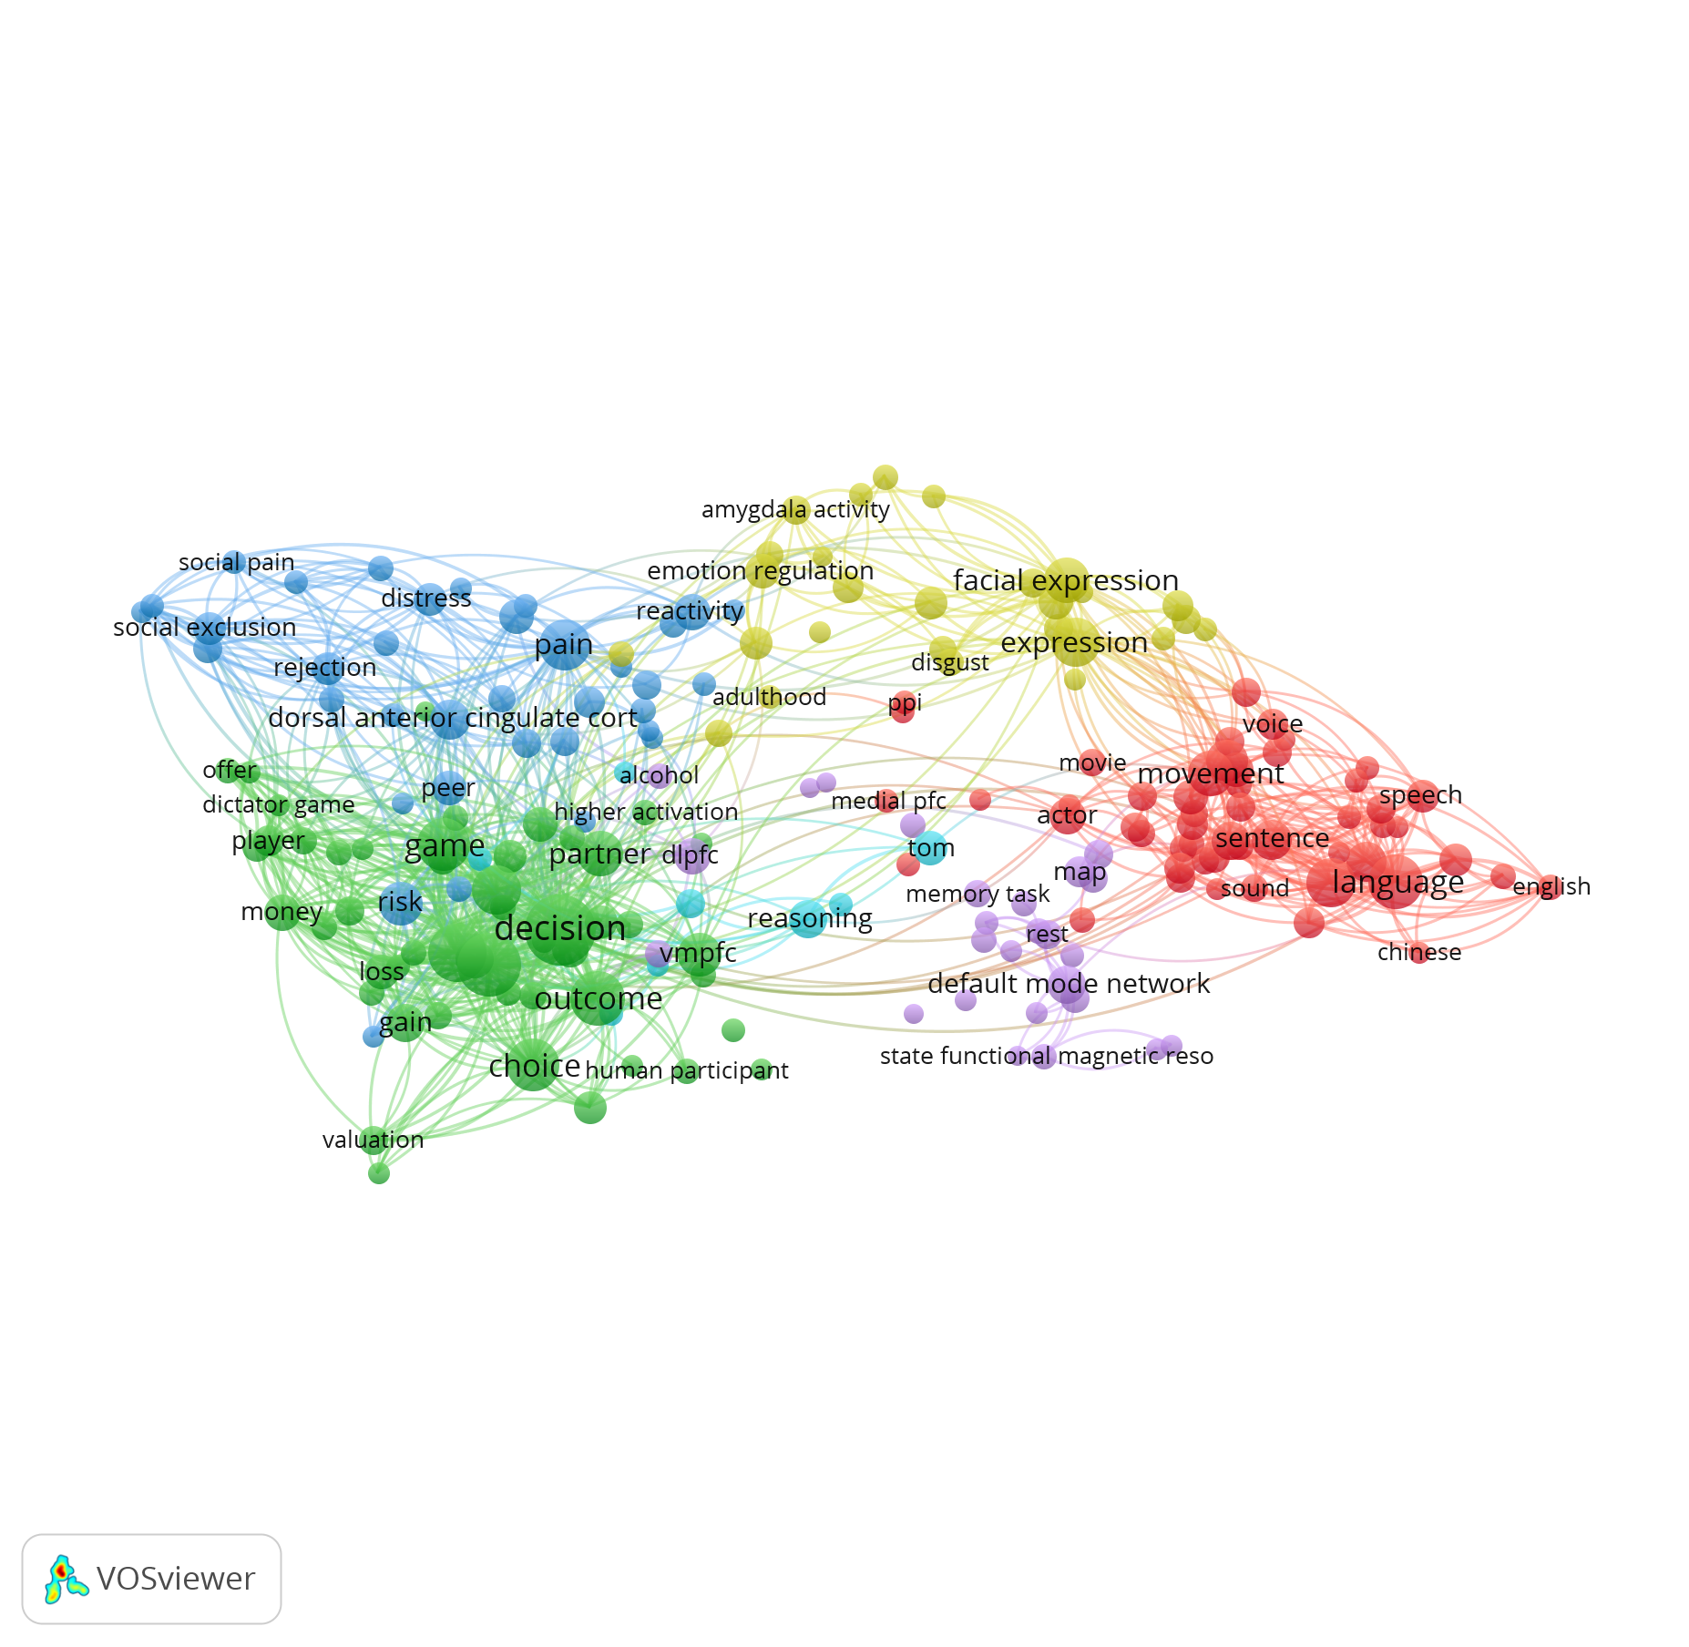
Title and abstract Binary counting Mentioned: >=15 Relevance: 200 (~30% most relevant records) Generic and age terms excluded

